Slide 1
ACI – Lab Session 2

Slide 2
Genetic Algorithm

Slide 3

Genetic Algorithm
Steps in Genetic Algorithm
Step 1-
Encoding technique- Binary encoding
Selection operator- Roulette Wheel Selection
Crossover operator- Single point crossover
Step 2-
Population size (n) = 4
Step 3-
Initial population (x value) = 13, 24, 8, 19

Slide 4
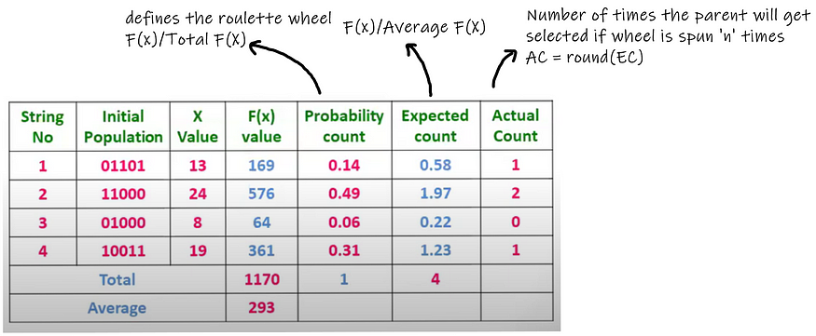
Genetic Algorithm
Step 4-
Calculate fitness
Survival rate or probability of selection

Slide 5
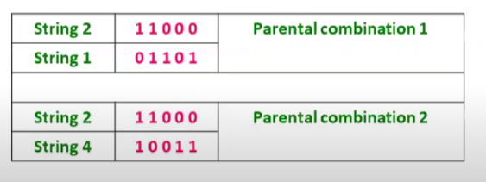
Genetic Algorithm
We see that if the Roulette wheel is spun four times, we’ll get 24 twice and 13 and 19 once. So possible parental combinations are (24,13) and (24,19).

Slide 6
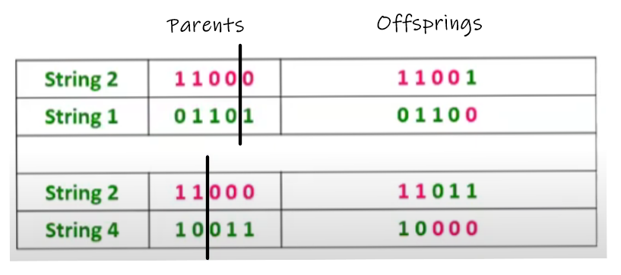
Genetic Algorithm
Step 5- Reproduction
1. Crossover
2. Mutation
1. Crossover – Swap the contents of the parents (solution) – In computing, parents can be represented as string, array, vector, etc.

Slide 7
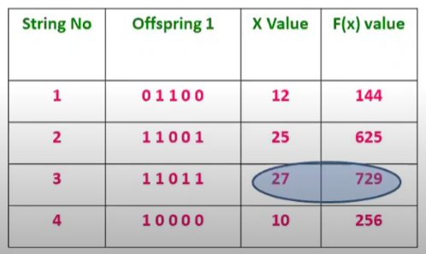
Genetic Algorithm
Step 6-
Calculation of fitness of off-spring
We can see that the maximum f(x) value has increased from 576 to 729.

Slide 8
Genetic Algorithm
Step 7-
Now we’ll take these four offsprings as parents and repeat the process until our termination condition is not satisfied.

